Slide 1

The Developments in Ukraine –
Political, Economic and Regulatory Aspects
Ukrainian Association of Investment Business
UAIB
Anastasiia Gavryliuk
UAIB Senior Analyst &
International Relations Coordinator
7th CEE Initiative Workshop “Challenges of Collective Investment Business in CEE”
17th – 18th September 2015, Ljubljana

Slide 2

Agenda
(I) Ukraine and the World – Continuing (geo)Political Turbulance
(II) Reforming of the Ukrainian Economy & International Support for Ukraine
(III) The Stock Market & Fund Industry Legal Framework Developments
(IV) The Ukrainian Economy and the Fund Industry Trends
7th CEE Initiative Workshop, 17th – 18th September 2015, Ljubljana

Slide 3

(I)
Ukraine and the World – Continuing (geo)Political Turbulence
7th CEE Initiative Workshop, 17th – 18th September 2015, Ljubljana

Slide 4
The Ongoing (geo)Political & Military Crisis
Nov 2013 – Feb/Mar/Apr 2014… – revolution /annexation / war
Mar - Jul - Sept - Dec 2014… – introduction and further widening of the EU (and the US) sanctions against Russia and former Ukrainian officials (extended until 23th June 2016 and until 6th Mar 2016)*;
17th Jul 2014 – downing of the MH17 Malaysian Airlines plane;
Aug 2014 – escalation of the war, massive shelling of Ukrainian industrial objects & civil residences in the east (Donbas region);
Sept 2014 - Feb 2015 – “Minsk agreements” – continuing violations (start of the next round in mid Sept 2015);
31st Aug 2015 – adoption in 1st reading of the Draft Law amending the Constitution of Ukraine (decentralisation) – protest outside the parliament (Rada);
25th Oct 2015 – local elections in Ukraine…
* See the European Commission’s Restrictive measures in force and EU sanctions against Russia over Ukraine crisis
7th CEE Initiative Workshop, 17th – 18th September 2015, Ljubljana

Slide 5
The Ukraine-European Union Association Agreement (AA)
21st Mar 2014 – signing of the ‘political’ part of the AA between the EU and Ukraine (Preamble, Article 1 and Titles I, II, and VII);
27th June 2014 – signing of the ‘economic’ part of the AA (Titles III, IV, V and VI, related Annexes and Protocols) – not in force yet *
Sept 2014 – Ukrainian Verkhovna Rada & the EU parliament ratified the AA;
Provisional application of Titles III, V, VI, and VII since 1st Nov 2014 (privileged access to the European market for Ukrainian companies);
Deferred application of the Free Trade Area (DCFTA) provisions until 2016
16th Mar 2015 – EU-Ukraine Association Agenda to prepare and facilitate the implementation of the AA
* 6/31 have not (fully) ratified, inlc. 6 countries: Belgium, Cyprus, Czech Republic, Greece, Netherlands; and the Council of the EU)
7th CEE Initiative Workshop, 17th – 18th September 2015, Ljubljana

Slide 6
(II)
Reforming of the Ukrainian Economy & International Support for Ukraine
7th CEE Initiative Workshop, 17th – 18th September 2015, Ljubljana

Slide 7
Ukrainian Reforms: what’s expected?
Short-term Priorities for Action according to the EU-Ukraine Association Agenda* (endorsed by the Association Council on 16th Mar 2015):
Constitutional reform
Election reform
Preventing and combating Corruption
Judicial reform
Public administration reform
Deregulation (in particular of SMEs)
Public procurement reform
Taxation reform, including VAT refunds
External audit
Energy Sector Reform
* See: http://eeas.europa.eu/ukraine/docs/st06978_15_en.pdf
7th CEE Initiative Workshop, 17th – 18th September 2015, Ljubljana

Slide 8
Ukrainian Reforms: the EU and US (Technical) Assistance
The EU and US (Technical) Assistance programmes:
TAIEX (regular events: workshops, expert missions etc. – in all areas) & Twinning instruments; SIGMA programme*
(EU) Assessment of approximation of the Ukrainian law to the EU acquis (company law, corporate governance, accounting & auditing, financial reporting – Dec 2014);
(EU) Technical Assistance in the Ukrainian Financial Sector‘s Priority Areas (Mar 2015 – a 3-year project);
Polish Assistance (2015; regular events);
USAID/FINREP-II (Second Financial Sector Development Programme, initially a 5-year project – until 2017; revised in 2015)
* See Funding and technical assistance of the EC.
7th CEE Initiative Workshop, 17th – 18th September 2015, Ljubljana

Slide 9
Ukrainian Reforms: the EU Technical Assistance
(EU) TECHNICAL ASSISTANCE IN THE UKRAINIAN FINANCIAL SECTOR'S PRIORITY AREAS
Purpose: To achieve the qualitative progress in the development of the Ukrainian financial services sector, the project will help in filling the crucial gaps in the respective policies, regulations and practices in Ukraine:
a. To enable the Regulators in the financial sector to introduce the financial reporting
standards according the XBRL taxonomy;
b. To approximate to the international standards in matters of micro-prudential banking oversight; to enhance National Bank’s of Ukraine (NBU’s) macro-prudential, counter cyclical and systemic risk supervision up to the standards of the ECB;
c. To strengthen the capacity of the NBU in implementation of the measures that to establish the necessary preconditions of the future gradual implementation of the free flow of capital;
d. To upgrade to the international standards the legal and regulatory framework for the audit profession in Ukraine;
e. To establish an Investor Compensation Scheme;
f. To implement the EU-recommended consolidated supervision of banking and nonbank financial institutions;
g. Implementation of Pillar 2 (Supervisory Review Evaluation Process) of Basel II.
7th CEE Initiative Workshop, 17th – 18th September 2015, Ljubljana

Slide 10
Ukrainian Reforms: trying hard… (on plans)
17 Sept 2014 – the government of Ukraine adopts the ‘Plan of Measures’ (Action Plan) for implementation of the AA for 2014-2017
Concerning Financial Sector:
Mar 2015: A roadmap for approximation of the Ukrainian legislation to the EU law in the field of financial services
Jul 2015: Implementation of Directive 2006/43/EC (Statutory Audits); Drafts for implementation of Fourth Directive 78/660/EEC (Annual Accounts), Seventh Council Directive 83/349/EEC (Consolidated Accounts), Directive 2013/34/EU (Accounting & Audit)
Aug 2016: Drafts for implementation of Directives 2002/92/EC & 2009/103/EC (Insurance), Directive 2003/41/EC (Pensions), Second Council Directive 77/91/EEC (as amended by Directives 92/101/EEC, 2006/68/EC)
Aug 2017: … Directive 2009/102/EC (Company law - Single-member Private LLC); Directive 2007/36/EC (certain rights of shareholders in listed companies);
2014-2017: Implementation of Basel requirements, FATF recommendations; Abiding by OECD Corporate Governance Principles; EC Recommendations 2004/913/EC and 2005/162/EC (on remuneration of directors of and on role of non-executive or supervisory directors of listed companies); Exchange of information, experience, conducting training, facilitation of the gradual convergence to the international standards of regulation and supervision (according to Chapter 6, Section IV of the AA)
7th CEE Initiative Workshop, 17th – 18th September 2015, Ljubljana

Slide 11
Ukrainian Reforms: trying hard… (on implementation)
Legislation adopted and changes made in terms of reforms:
7th CEE Initiative Workshop, 17th – 18th September 2015, Ljubljana

Slide 12
Ukrainian Reforms: trying hard… (to get funding)
The Rada adopts 5 Laws necessary to ensure granting of the $3.2 billion of financial support to Ukraine from international partners:
of 16th Jul 2015
Law on improving the Deposit Guarantee System and elimination of insolvent banks from the market (№629-VIII);
Law on the abolition of the moratorium on the alienation of property of debtor companies of the state company "Naftogaz" (№627-VIII);
Two acts aimed at increasing the efficiency of the Anti-Corruption Bureau (№628-VIII and №631-VIII);
of 2nd Jun 2015 the Law on the formation of tariffs on utilities, (№ 499-VIII) – the condition set by Japan and Germany)
7th CEE Initiative Workshop, 17th – 18th September 2015, Ljubljana

Slide 13
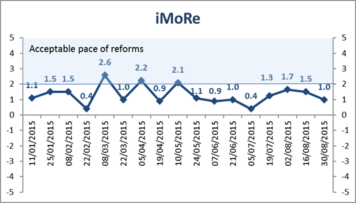
Ukrainian Reforms: trying hard… (assessment)
Where are the reforms? Assessment of the government's actions over H1 2015 (Index for Monitoring Reforms, іMoRe*) – Jul 2nd, 2015
Changes since then:
Jun 22nd – Jul 5th, 2015. Almost complete silence in reforms
Jul 6th –19th, 2015. Strengthening independence of the National Bank
Jul 20th –Aug 2nd, 2015. Noticeable acceleration of reforms
Aug 3rd –16th, 2015. Many small steps towards reducing corruption
Aug 17th –30th, 2015. Government external debt restructuring…
* For more about iMoRe see: http://imorevox.in.ua
7th CEE Initiative Workshop, 17th – 18th September 2015, Ljubljana

Slide 14
Ukrainian Reforms: trying hard… (further work)
Drafting of new/amended legislation
Two Drafts on Tax Reform (by the Rada and by the government) – ongoing discussions as of mid Sept 2015; to be adopted by 2015 end
According to the EU-Ukraine Association Agenda (III. OPERATIONAL PART, 7.2 Taxation), the Parties aim at (…) preparation for gradual approximation to the taxation structure as laid down in the EU acquis set out in the relevant annex of the Association Agreement
Constitutional Reform – the Draft Law (initiated by the President) №2217а of 1 Jul 2015 amending the Constitution of Ukraine on decentralisation – adopted in 1st reading by the Rada on 31st Aug 2015
Administrative & Deregulation Reform
Pension Reform…
7th CEE Initiative Workshop, 17th – 18th September 2015, Ljubljana

Slide 15
The EU (Financial) Support for Ukraine
May - Jun - Nov - Dec 2014 – Apr 2015 – the EU Macro-Financial Assistance (MFA) loans provided to Ukraine amounting to €1.61 billion
“…to support Ukraine economically and financially in the current critical stage of its development.”
Mar - May 2015 – the EU Council and Parliament approve €1.8 billion in loans (including new MFA) - the EU and Ukraine sign MoU for the financial assistance
(Since early 2014, the EU has provided close to €2 billion in assistance in the form of low-interest loans and budgetary grants)
Apr 2015 – 17th EU-Ukraine Summit; International Conference on Support for Ukraine: EU announces €110 million support for SMEs and entrepreneurship in Ukraine
Sept 2015 – $100 million approved by Poland;
$200 million expected from Germany
7th CEE Initiative Workshop, 17th – 18th September 2015, Ljubljana

Slide 16
The IMF, WB, EBRD, US and other countries (Financial) Support for Ukraine
IMF – $6.7 billion provided under the Extended Fund Facility (EFF) only in 2015 (out of $17.5 billion overall approved loan)
WB (IBRD) – $3.6 billion overall provided over 15 months (since Jun 2014 through Aug 2015) (+ €500 million approved under DPL 2 in Aug 2015)
EBRD & EIB – €1.2 billion in 2014 (about same expected in 2015; EBRD total commitment of €11 billion in 345 projects, €5 billion in current portfolio)
USA – $1 billion of approved guarantees – expected in autumn 2015
Japan – $300 million expected
Norway – $24 million expected
(!) On 27th Aug 2015 Ukraine has negotiated writing off of $3.8 billion out of $19.3 billion (20%) of government debt and on restructuring of the rest of it (with repayment in 2019-21 through new eurobonds, derivatives)
On 9th Jul 2015 Ministry of Economic Development and Trade of Ukraine launched a commercial about the investment potential of the country (see “Ukraine. Open for U”) – before the 1st US-Ukraine Business Forum (13th Jul 2015).
7th CEE Initiative Workshop, 17th – 18th September 2015, Ljubljana

Slide 17
Ukrainian Reforms: trying hard…
(EBRD Support on fighting Curruption)
Business Ombudsman Council:
become operational on 20 May 2015
key element in an Anti-Corruption Initiative (launched by the EBRD; agreed under MoU of May 2014 with the EBRD, OECD, EBA Am. CC in Ukraine)
Algirdas Šemeta (former Lithuanian Finance Minister, former EU Commissioner for Taxation and Customs Union, Audit and Anti-Fraud)
will regularly report to the general public about the progress made
1st quarterly report on 28 Jul 2015 (172 complaints processed)
funded by the EBRD-Ukraine Stabilisation and Sustainable Growth Multi-Donor Account (supported by Denmark, Finland, France, Germany, Japan, the Netherlands, Poland, Sweden, Switzerland, the UK and the US).
7th CEE Initiative Workshop, 17th – 18th September 2015, Ljubljana

Slide 18
(III)
The Stock Market & Fund Industry Legal Framework Developments
7th CEE Initiative Workshop, 17th – 18th September 2015, Ljubljana

Slide 19
The EU Legislation (on Financial Services) to be Implemented According to the AA with the EU
During 4 years since the AA entry into force (i.e. full ratification)
the EU law to be implemented:
UCITS (2009/65/EC) – 6 Directives & Regulations
MiFID (2004/39/EC)
Prospectus Directive (2003/71/EC)
Transparency Directive (2004/109/EC)
ICSD (1997/9/EC)
+ Implementing Directives & Regulations – overall 24 legal acts concerning investment funds & securities*
* Also 13 Directives on banking and 5 ones on insurance and pensions
7th CEE Initiative Workshop, 17th – 18th September 2015, Ljubljana

Slide 20
New Legislation & Regulatory Environment
Tax Code amendment abolishing the excise tax on transactions in securities – in force as from 1st Jan 2015 (the tax was in force for 2 years)
Law on Financial Monitoring amendments – new Law version of 14th Oct 2014 №1702-VII (as amended) – determining the ultimate beneficiary owners (UBOs) of legal entities and public figures (unit CII do not have UBOs – NSSMC) – in force as from Feb 2015
Law On licensing of economic activities – new consolidated Law of 2nd Mar 2015 №222-VIII – requirements as for the control over the professional stock market participants by the “countries engaged in armed aggression against Ukraine” – in force as from 29th Jun 2015
National Securities and Stock Market Commission (NSSMC) Regulations:
10th Jul 2015 – Regulation №980 on the establishing of signs of fictitiousness of securities issuers and on inclusion of such issuers in the respective list
24th Jul 2015 – NSSMC accepts evidence of control by the “countries engaged in armed aggression against Ukraine” (Russia) of 5 banks, recalling their stock market licences
7th CEE Initiative Workshop, 17th – 18th September 2015, Ljubljana

Slide 21
Foreign Securities Trading in Ukraine – Status Quo
NSSMC Regulation On the Admission of Securities of Foreign Issuers to Trading in Ukraine № 1692 of 22nd Nov 2012 – issuers with assets in Ukraine only
NSSMC Regulation On Approval of the List of Foreign Stock Exchanges, Where Foreign Securities Must Be Listed to Be Admitted to Trading in Ukraine № 1754 of 10th Sep 2013 – 69 SEs globally
First admission on 14th Jan 2014 – equities of Ukrproduct Group (Jersey)
Second admission on 7th Oct 2015 – GDRs of MHP SA (Lux)
Both traded initially at the LSE, in Ukraine are traded at the Ukrainian Exchange (UX) (2nd Feb 2015 – 1st trading day)
BUT – the old issues remain topical:
…the currency liberalization by the NBU is still needed (only brokers with general currency licence of the NBU are allowed);
… the National (Central) depositary needs to establish correspondent relations with foreign depositaries, in particular with Euroclear (still established only with Clearstream (provides indirect access to Euroclear), Austrian OeKB and a few Russian depositaries)
7th CEE Initiative Workshop, 17th – 18th September 2015, Ljubljana

Slide 22
Drafting New/Amended Legislation Concerning Financial Markets
7th CEE Initiative Workshop, 17th – 18th September 2015, Ljubljana

Slide 23
NSSMC Key Draft Laws
31st Jul 2015 – NSSMC Draft Law on expanding the powers of NSSMC (Draft Law “On amendments to some legislative acts of Ukraine on the implementation of IOSCO standards and implementation of the Association Agreement between Ukraine and the European Union in terms of combating abuses in the stock market”) – published but not yet registered with the Rada
On Investor Compensation Schemes – recurring initiatives to involve AMC & CII (claiming to implement Directive 97/9/EC) – the latest Draft Law Concept as of 4th Jun 2014, new Draft Law expected shortly…)
7th CEE Initiative Workshop, 17th – 18th September 2015, Ljubljana

Slide 24
Key Draft NSSMC Regulations
26th Dec 2014 - 8th Sept 2015 – Draft of revised (consolidated) Regulation on Prudential Supervision & Risk Management (Regulation №1 of 9 Jan 2013 covering AMCs – in force) – big impact on the asset management industry
8th Jul 2015 – Draft amendments of the Regulation on the carrying out of financial monitoring by professional participants of the securities market (to bring in line with the Law on Financial Monitoring)
Apr 2015 – Draft Concept of Functioning of an Institute of a Temporary Administrator of a Professional Stock Market Participant (referring to Art. 38 of the Insolvency Regulation (EC) 1346/2000) – dismissed
7th CEE Initiative Workshop, 17th – 18th September 2015, Ljubljana

Slide 25
(IV)
The Ukrainian Economy and the Fund Industry Trends
7th CEE Initiative Workshop, 17th – 18th September 2015, Ljubljana

Slide 26
Key Economy and Stock Market Indicators
GDP 2014 – just below EUR 100 bn;
(per capita –
EUR 2.3 thsd)
* Excluding the temporarily occupied territories of the AR of Crimea and the city of Sevastopol, for Q4 2014 and 2015 also excluding the part of the ATO zone.
State Statistics Service of Ukraine data.
Data on NBU Reserves, exchange rates - NBU.
7th CEE Initiative Workshop, 17th – 18th September 2015, Ljubljana

Slide 27
Key Economy and Stock Market Indicators (cont.)
*The 3 main SEs out of total 8 SEs in Ukraine have 274 / 1,305 / 703 securities listed (the UX SE / PFTS SE / Perspectyva SE respectively).
There are 192 + 853 issuers listed at the UX SE and PFTS SE.
SEs and NSSMC data.
** 71 out of 72 securities in the UX 1st list.
7th CEE Initiative Workshop, 17th – 18th September 2015, Ljubljana

Slide 28
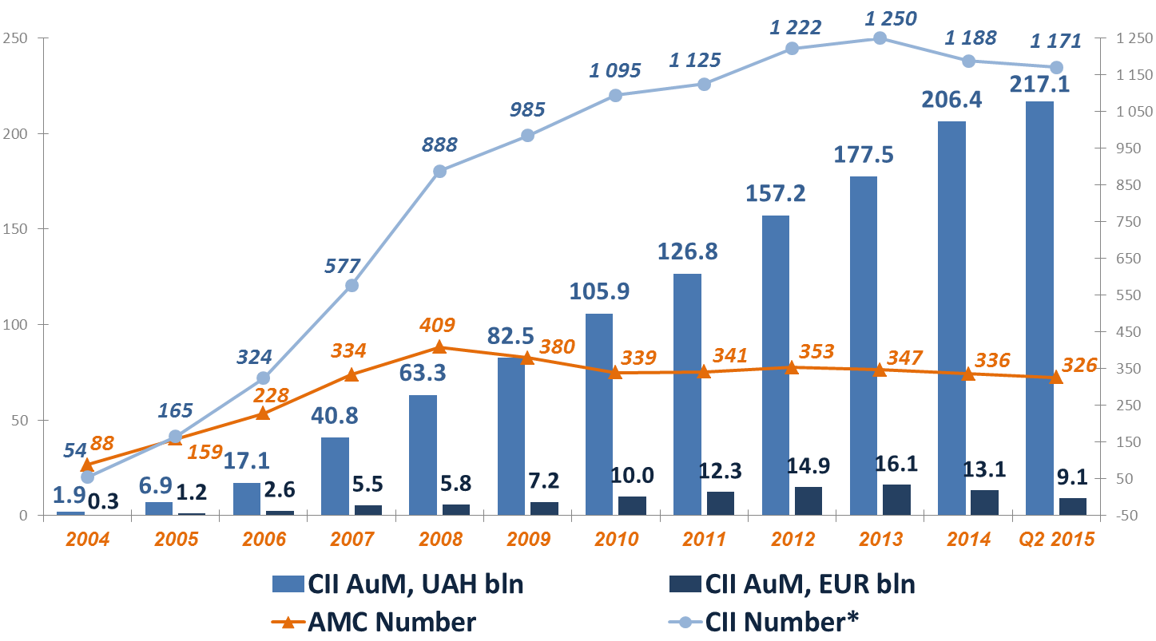
The Fund Industry Dynamics
Total assets of all CII comprised 13% of GDP and compared to 16% of banks assets in 2014
As at 31st Jul 2015, total AuM of all CII, NPFs and IC reached UAH 220.5bln (EUR 9.3bln)
* Established funds (those that reached compliance with the minimum asset value standard)
7th CEE Initiative Workshop, 17th – 18th September 2015, Ljubljana

Slide 29
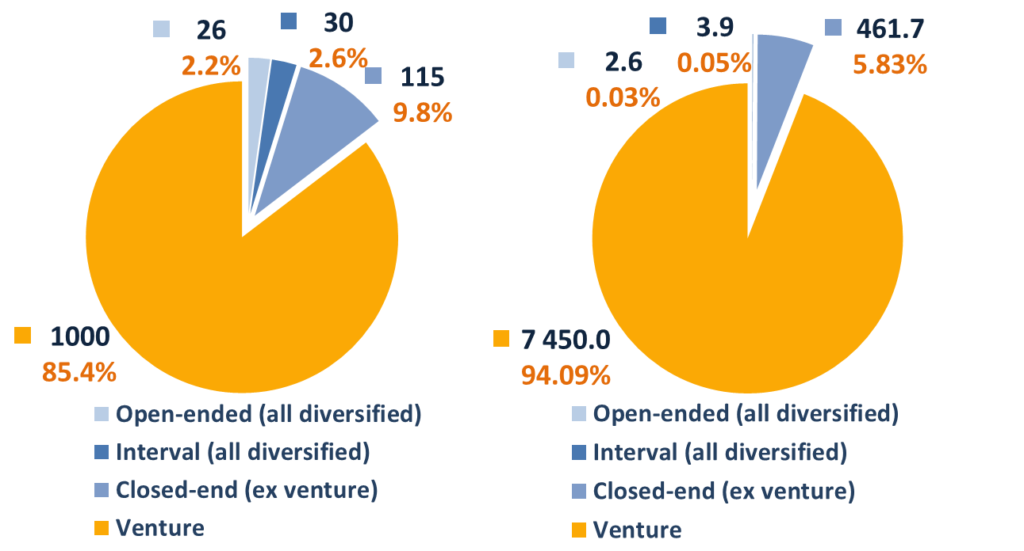
Collective Investment Institutions (CII)
by Number of funds*
by NAV, EUR mln
* CII that reached compliance with the minimum asset value standard and provided quarterly reports as at 30th Jun 2015
7th CEE Initiative Workshop, 17th – 18th September 2015, Ljubljana

Slide 30
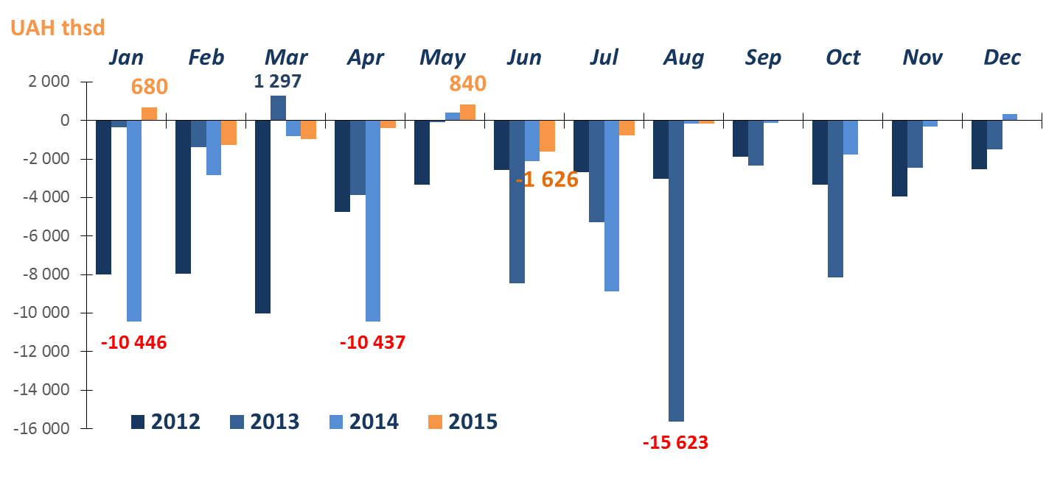
Net Sales of Open-ended Funds
Annual outflow for 2012 - 2013 - 2014: UAH 54mln - UAH 48mln - UAH 37mln (according to the NBU av. UAH exchange rate: EUR 5.3mln - EUR 4.5mln - EUR 2.4mln)
Quarterly net sales have been negative starting from Q3 2011 (for 16 quarters) – UAH 197mln overall as at 30th Jun 2015
7th CEE Initiative Workshop, 17th – 18th September 2015, Ljubljana

Slide 31
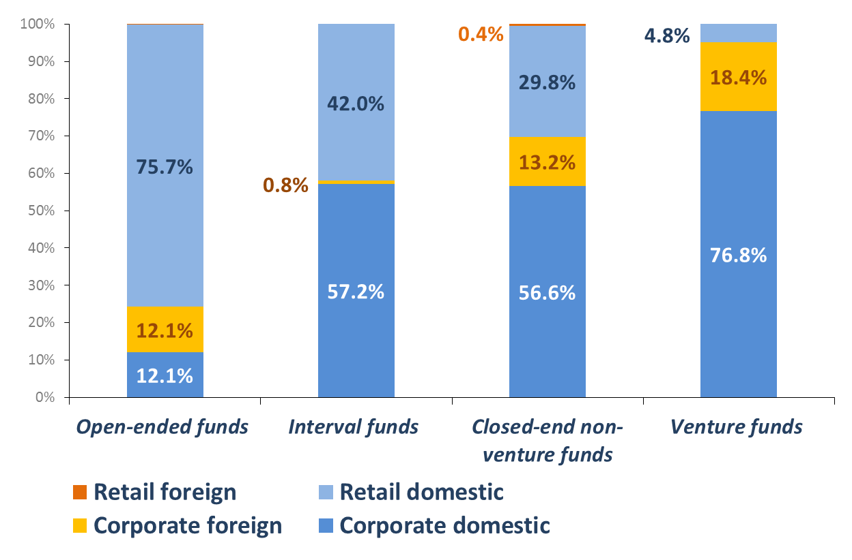
Investors of the CII, by Fund Type, % of Total NAV, as at 30 Jun 2015
Number of domestic retail investors in open-ended funds – 2,760 (out of total 2,791)
Their holdings amount to UAH 47mln (EUR 2mln) in open-ended funds, UAH 11,814 in all CII (EUR 496mln, incl. EUR 355mln in venture funds – 71.5%)
Foreign investors hold UAH 33,933mln (EUR 1,423mln) in all CII (95.6% – in venture funds). Their total number is 609 (incl. 567 legal entities) out of which 542 – in venture CII (9.7% of investors in those funds).
7th CEE Initiative Workshop, 17th – 18th September 2015, Ljubljana

Slide 32

Thank you!
Any questions?
Anastasiia Gavryliuk
Senior Analyst & International Relations Coordinator
gavrylyuk@uaib.com.ua
Ukrainian Association of Investment Business (UAIB)
28 Predslavynska Str., off. 301,
Kyiv 03680, Ukraine
Tel./Fax: +38 044 528 72 66/70
http://www.uaib.com.ua
7th CEE Initiative Workshop, 17th – 18th September 2015, Ljubljana

